Slide 1
Intelligent Companion Robot
Team 7: Zhijie(Jack) Zhou, JinFeng He

Slide 2
Key Insights
Provide emotional support and interaction for users
Talk like your closest “buddy”
Responds to user voice and touch through different sensors
Emotion faces dynamically generated through pygame
Displays expressive emotions and personality in real-time
Base state: Keep Smiling is always the best!
Active state: talking expression(animated mouth and eyes)

Slide 3
motivation
Desktop pet
Test Raspberry Pi 4’s capacity with local LLMs

Slide 4
hardware components
Raspberry Pi 4
piTFT
Mini microphone
Speaker on wm8960-soundcard
256GB USB drive

Slide 5
software components
Configuration file in setting.yaml
STT pipeline:
  PyAudio capture + WebRTC VAD in audio_input.py
  Adaptive VAD in voice_detect.py
  Realtime STT (faster-whisper) in stt_engine.py
  End-to-end integration in with callbacks/stats in voice_pipeline.py
LLM and conversations:
  Context with personality prompt engineering, emotion-tag parsing, streaming segmentation, response filtering, history in conversation_manager.py
  Integration with STT, LLM, TTS with callbacks and stats in conversation_pipeline.py
  Ollama API (qwen2.5:0.5b) in ollama_client.py
TTS pipeline:
  Piper backends, emotion-modulated speech, segmented speaking in tts_engine.py
Emotion and personality:
  state machine, traits, decay, boosts in emotion_engine.py
Display/expressions:
  threaded controller, priority for listening/speaking/emotion, transitions, touch gestures in emotion_display.py
Memory:
  SQLite helper in database.py
Scripts for different tests and demo

Slide 6
functionalities
Voice loop
LLM conversation
Emotion system
Expression display
TTS output
Memory model

Slide 7
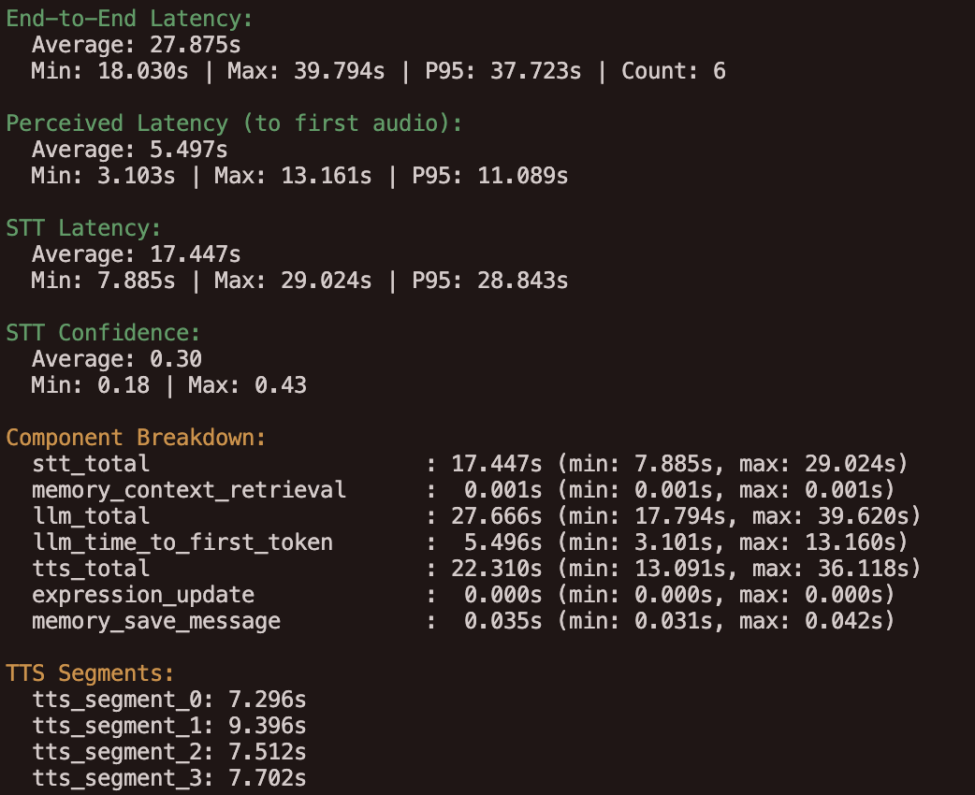
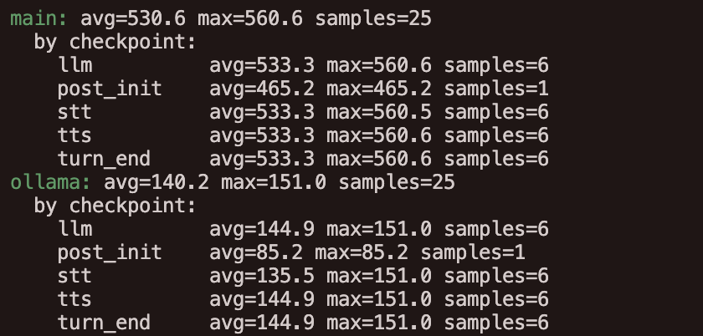
system performance

Slide 8
roadblocks
From llama3.2:3b, to tinyllama:latest to llama3.2:1b, to qwen2.5:0.5b
From Whisper to faster whisper
WM8960 audio card connecting issue and package conflicting with PulseAudio
Fine Tuning for smoothness

Slide 9
worked well
Strictly follow the implementation plan
Modularized implementation

Slide 10
worked not well
Remember each week’s progress report

Slide 11
future features
Apply computer vision to track people movements (or create eye contact)
Toggle an advanced mode by using cloud api for better performance and memory storage

